Slide 1
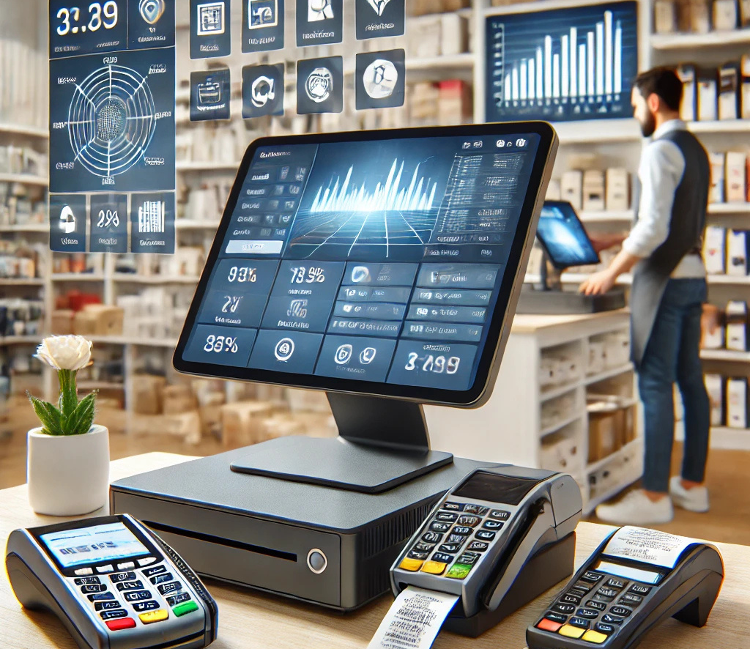


POS SYSTEM
Presented by
22IT458 :Dhyey Bhanderi
22it460 :Neel Dobariya
Guide Name:Prof.Dharmesh G Patel

Slide 2

Table of content
Introduction
Modules
Requirements
Feasibility Study
System Features
Requirement Gathering
SWOT Analysis
Diagrams

Slide 3
INTRODUCTION
In modern retail and hospitality businesses, efficient and accurate sales processing is crucial.
The current sales management process relies on outdated methods, leading to inefficiencies, errors, and delays.
A Point of Sale (POS) system is required to:
Streamline operations
Enhance customer experience
Improve decision-making with real-time data
This project focuses on developing a POS system with integrated inventory management, real-time tracking, and multi-payment support.

Slide 4
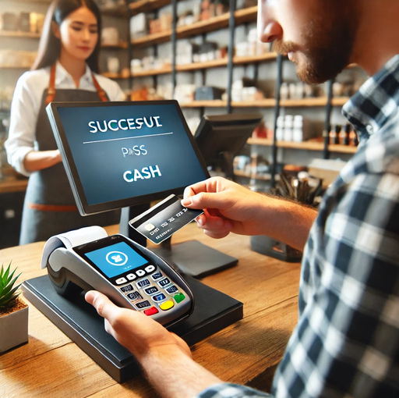
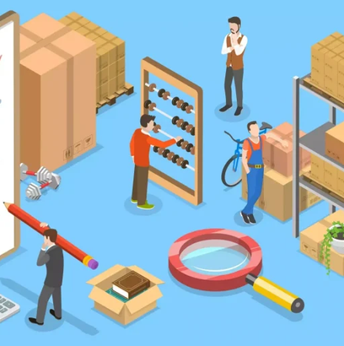
Modules
1. SALES MANAGEMENT
2. INVENTORY MANAGEMENT
Handles all sales activities from item scanning to payment processing.
Item Scanning
Price Calculation
Payment Processing
Receipt Generation
Manages stock levels and updates inventory in real time.
Stock Entry
Stock Adjustment
Inventory Tracking
Low Stock Alerts

Slide 5


Modules
3. CUSTOMER MANAGEMENT
4. AUTOMATED SALES PROMOTION
Enhances customer experience and tracks purchasing behavior.
Customer Data Entry
Purchase History Tracking
Uses analytics to optimize sales and promotions.
Real-Time Analytics
Report Generation

Slide 6

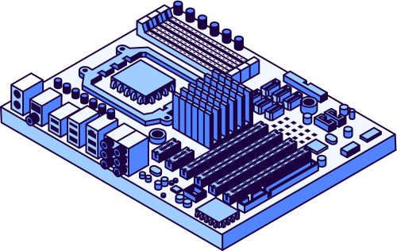
SOFTWARE
HARDWARE
Backend: Node.js, Express.js
Frontend: React.js, UI extensions
Database: MongoDB
Other Tools:
Git for version control
VS Code for development
Requirements
Windows 10 or later, 4 GB RAM, 500 MB free disk space.
Barcode scanner and receipt printer (optional)

Slide 7
1
TECHNOLOGICAL FEASIBILITY
Uses modern, well-documented tools (Node.js, React.js, MongoDB).
Team expertise ensures smooth implementation.
Feasibility Study
2
OPERATIONAL FEASIBILITY
Enhances transactions, inventory tracking, and customer experience.
Reduces manual errors and inefficiencies.
The POS system is technologically viable, cost-effective, and enhances operations. It ensures compliance with industry standards and is scheduled for completion in 3–4 months.
3
FINANCIAL FEASIBILITY
Low cost: Open-source tools, optional hardware.
Savings: Automation reduces labor and errors.
ROI: Boosts sales, scalable for long-term benefits.
4
LEGAL & COMPLIANCE FEASIBILITY
Adheres to GDPR and industry payment standards.

Slide 8
System Features
Sales Management – Barcode scanning, automatic price calculation, multi-payment support, and receipt generation.
Inventory Management – Real-time stock tracking, low-stock alerts, stock adjustment, and automated updates after sales.
Customer Management – Customer registration, purchase history tracking, and personalized promotions.
Automated Sales Promotion – AI-driven discounts, targeted marketing, and real-time sales insights.
Multi-User & Role-Based Access – Secure access for cashiers, managers, and admins with role-based permissions.
Payment Integration – Supports cash, credit/debit cards, and digital wallets for seamless transactions.

Slide 9

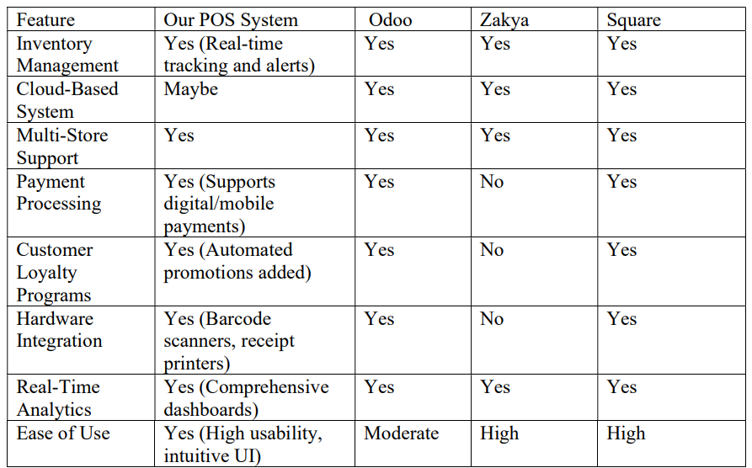
Requirement Gathering
COMPARISON WITH EXISTING SYSTEMS
TECHNIQUES USED
Stakeholder Interviews
Surveys & Questionnaires
Observation
Document Analysis
Workshops & Brainstorming
Prototyping

Slide 10

SWOT ANALYSIS
🔹 Threats ⚠
Cybersecurity Risks
Competition
Regulatory Changes
🔹Weaknesses ❌
Initial Setup Cost
Learning Curve
Internet Dependency
🔹 Strengths ✅
🔹 Opportunities 📈
Real-time Sales & Inventory Tracking
Multi-Payment Support
Automated Sales Promotions
User-Friendly Interface
Security & Compliance
Scalability
AI & Analytics
Mobile Integration

Slide 11

Diagrams
DFD
Activity
Class
ER
Sequence
State
Usecase

